Slide 1

Spot the safe choice
Look up, look down and look all around to stay safe around electricity.
Notes:
Electricity helps us – but we don’t play near it.

Slide 2
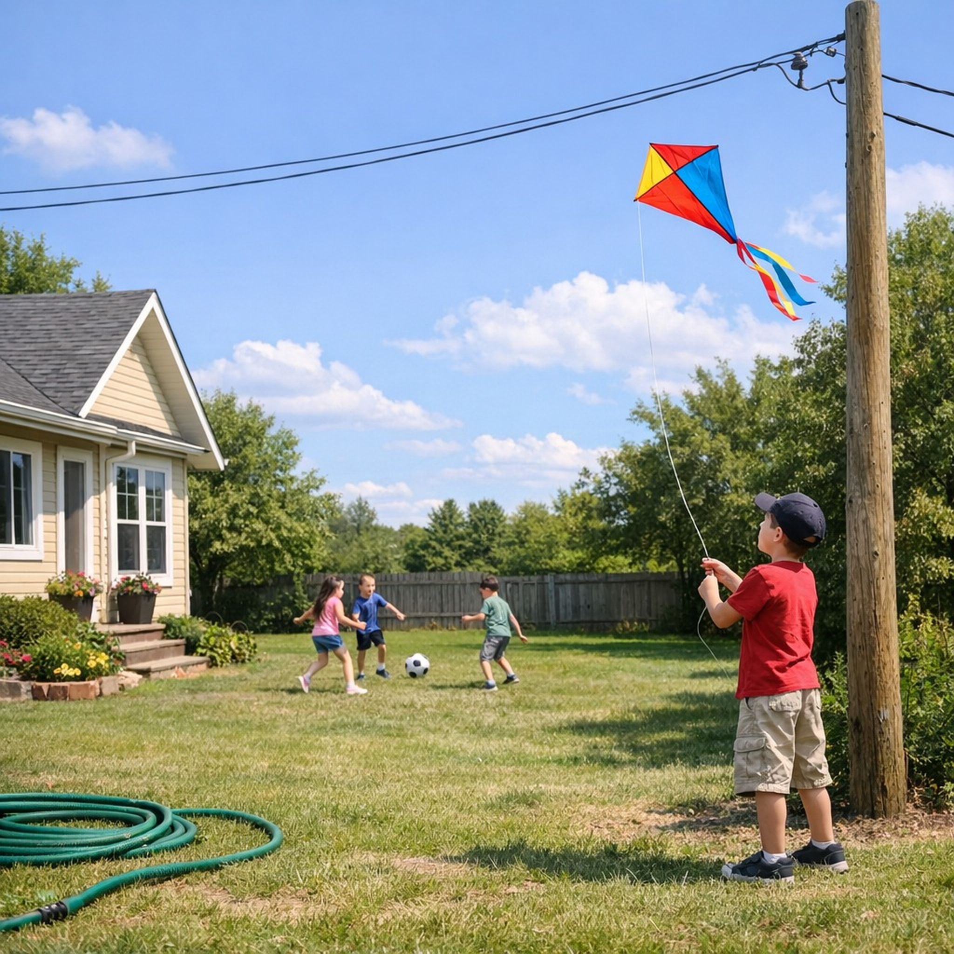
How to spot a safe choice
Look UP for wires.
Look DOWN for cords.
Look ALL AROUND before you play.
Click the SAFE choice.

Slide 3
✅ Kids playing ball far away from power lines.
Great job! You looked UP and chose a safe place to play!
Next choice.

Slide 4
❌ Kite flying near power lines.
Uh-oh! Kites can touch power lines. Let’s choose a safer spot.
Try again.

Slide 5

At the park
Can you spot the safe choice?

Slide 6
✅ Playing on the playground away from wires.
Yes! You looked ALL AROUND and found a safe place!
Next choice.

Slide 7
❌ Climbing a tree close to power lines.
Trees near wires are not safe. Let’s look again!
Try again.

Slide 8
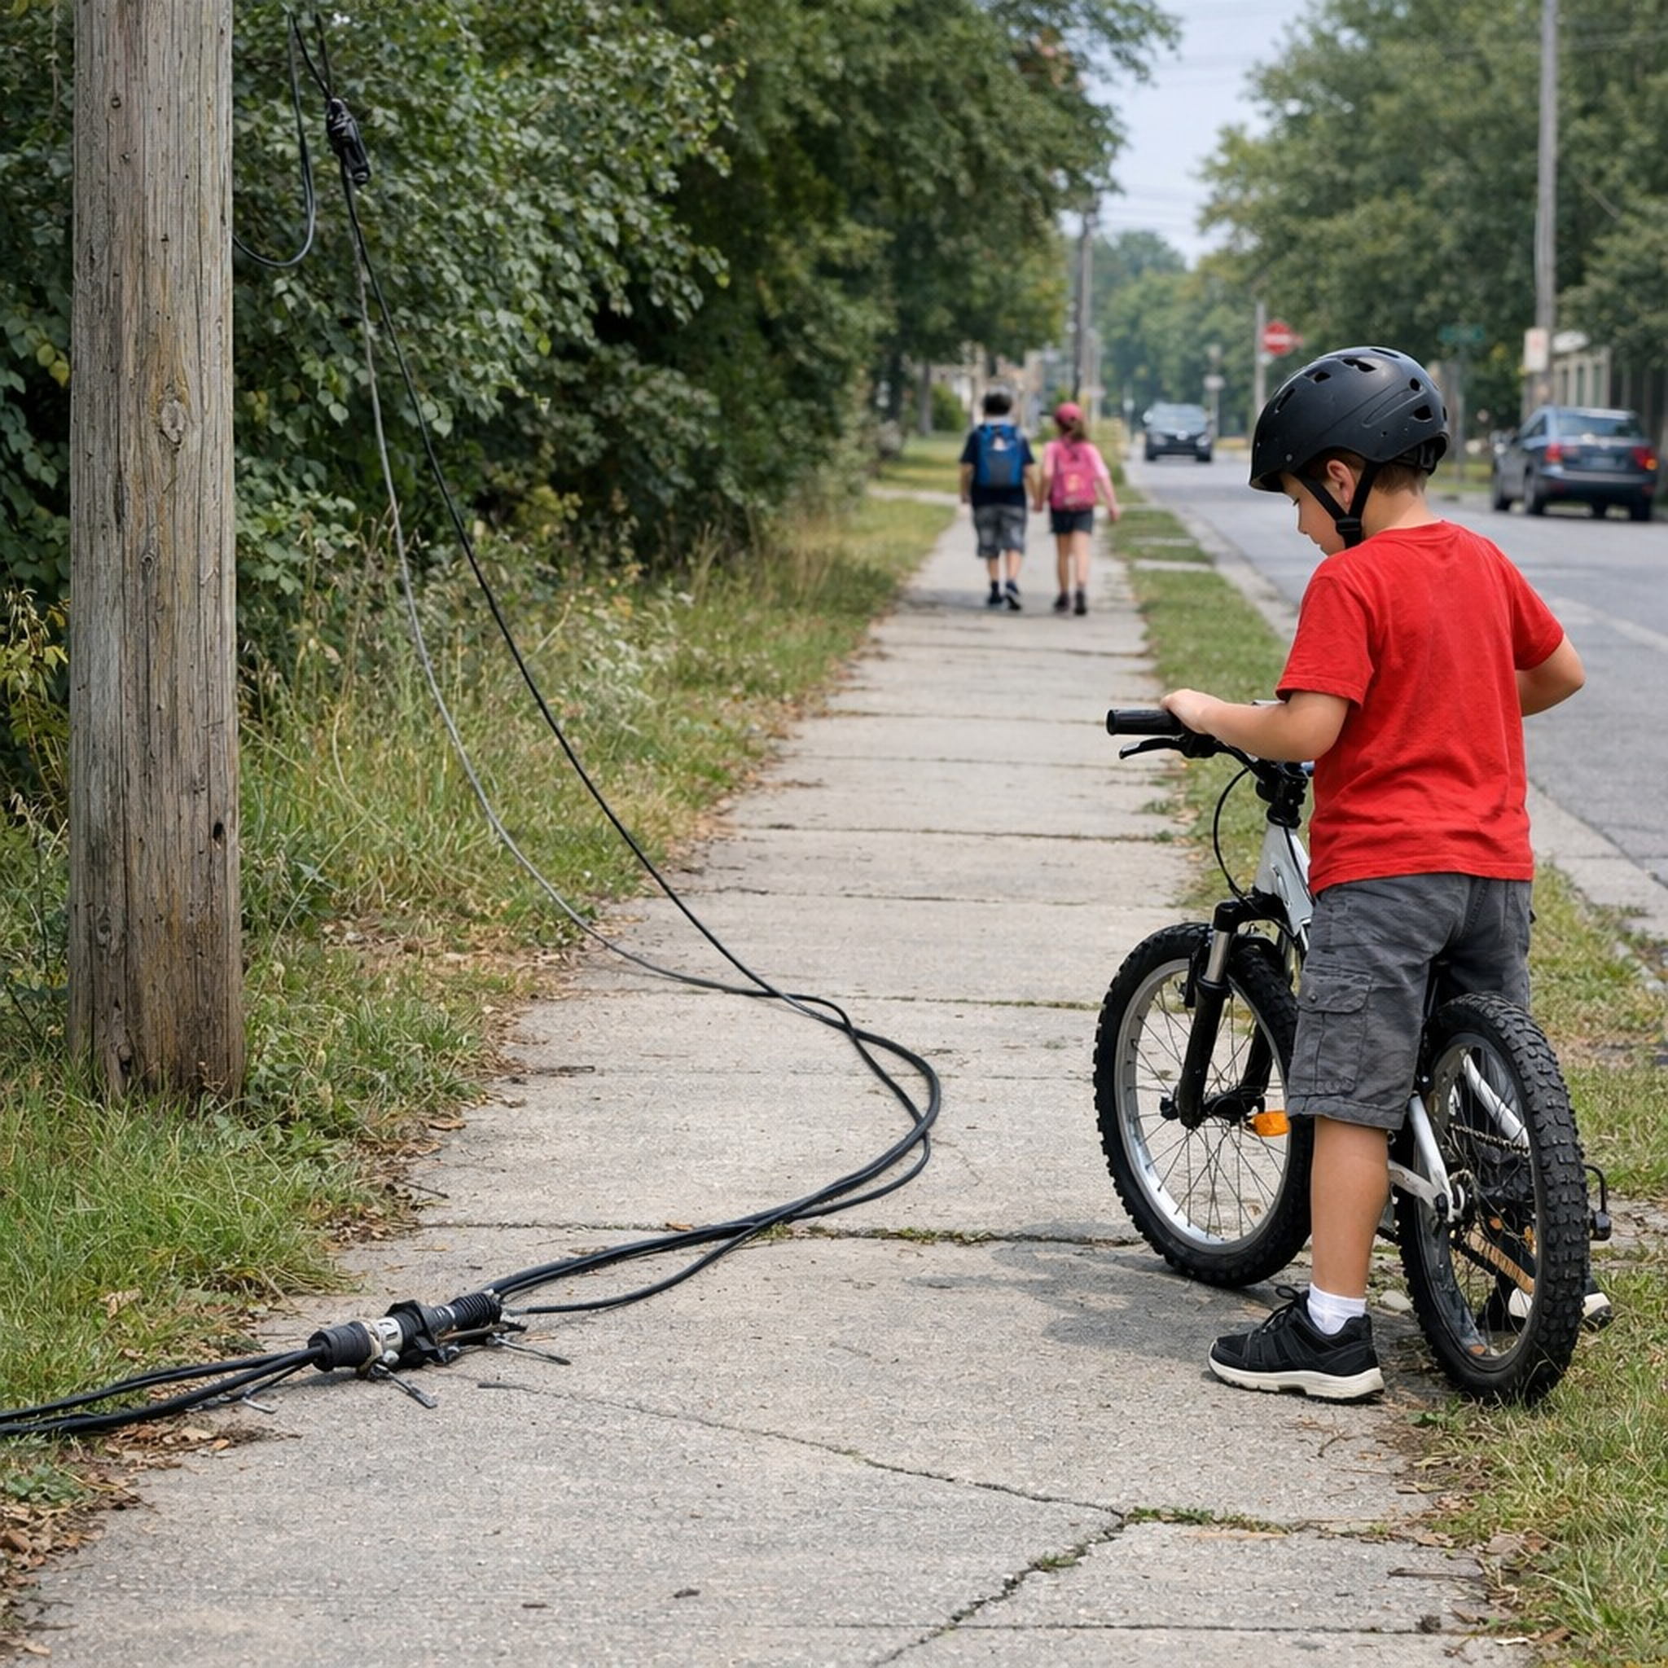
On the street
Can you spot the safe choice?

Slide 9
✅ Walking far away from the line.
Awesome! You looked DOWN and stayed far away from the power line!
Next choice.

Slide 10
❌ Going near or touching a downed line.
Stop! Lines on the ground are dangerous!
Try again.

Slide 11

Inside safety
Can you spot the safe choice?

Slide 12
✅ Playing with toys away from outlets.
This child is playing safely away from cords!
Next choice.

Slide 13
❌ Touching cords or outlets.
Cords and outlets are not toys. Let’s stay safe!
Try again.

Slide 14

Great spotting!
You looked carefully and made safe choices.

