Slide 1
“Homing” in on energy efficiency

Slide 2
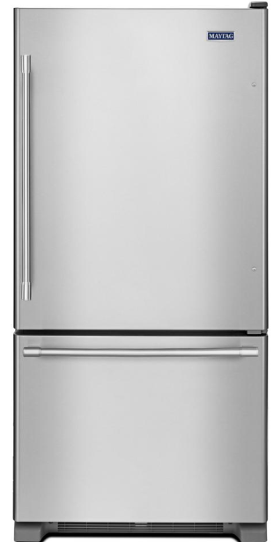
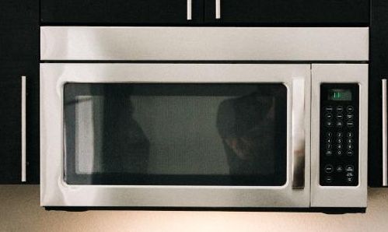
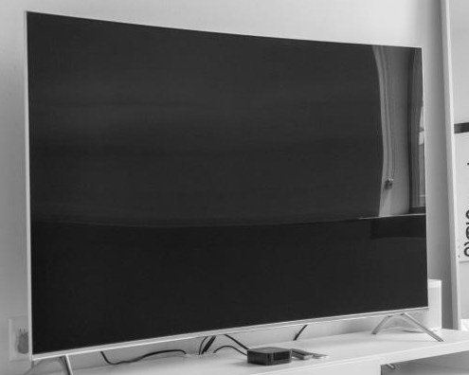
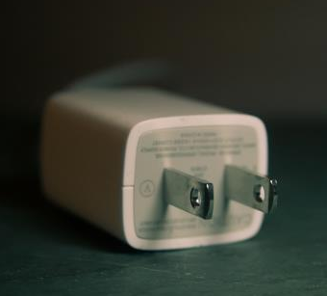
What’s the wattage?
30 watts?
4 watts?
30 watts?
4 watts?
30 watts?
4 watts?
30 watts?
4 watts?
30 watts?
4 watts?
30 watts?
4 watts?
30 watts?
200 watts?
1200 watts?
200 watts?
1200 watts?
200 watts?
1200 watts?
200 watts?
1200 watts?
200 watts?
1200 watts?
200 watts?
1200 watts?
200 watts?
1200 watts?
4 watts?
Watts measure the amount
of work that electricity does.
Notes:
Setting the stage (1 slide: 3 – 5 minutes)
This slide is meant to set the stage. There is a short activity and discussion on the energy required to power different appliances/devices.
Have this slide on display as students enter the classroom. If that’s not possible, be sure to leave it up for at least 30 seconds before introducing the activity.
Ask students what they think is going on in the slide with the images and the different numbers of wattages — i.e., each image corresponds with one of the numbers of watts.
Let them know that you’ll be exploring energy use in this lesson and that different items at home consume different levels of energy, often measured in watts. Of the four images on the slide, have them speculate on which one uses 4 watts. They will likely guess correctly that it’s the phone charger. Then ask them to quickly (and silently!) figure out the ascending order for the other three.
Here’s the correct order:
4 watts = cell phone charger
30 watts = television
200 watts = refrigerator
1200 watts = microwave oven
Ask a few students to share the order they came up with. If all have the same order, see if anyone has a different order. (Because a refrigerator is bigger than a microwave, some students may assume that it’s the 1200 watt appliance.) As a result of this quick activity, students should be able to recognize that
Different devices require different amounts of energy/electricity to power them
As evidenced by the refrigerator vs. the microwave, it’s not influenced only by the size of the object.
Watts are a common measurement for energy use
Ask students to try to define watts. Have a few students attempt to define it.

Slide 3

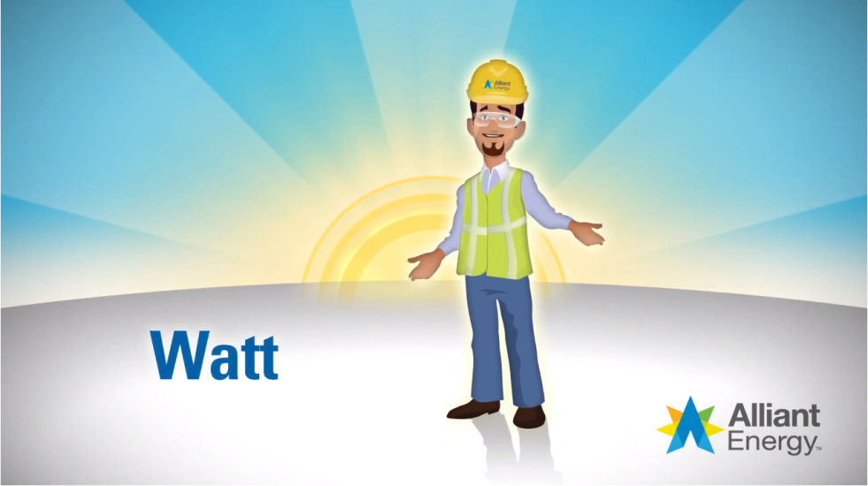
What’s wattage?
Notes:
Defining Watts (1 slide: 3 – 5 minutes)
This slide provides an animated definition for “watts.” It will help ensure that students have a foundational understanding of different energy requirements for different devices.
Before showing the definition of “watts,” ask which of the definitions that students shared they believe is the best explanation of “watts” or “wattage.”
Show the video definition: https://www.youtube.com/watch?v=xzsHkF1Mqvg
Ask students to identify and share any new information about “watts” that wasn’t within any of the attempts to define the term.

Slide 4

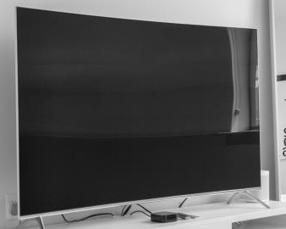


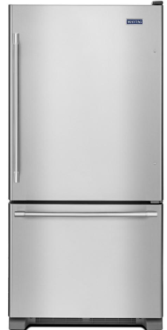

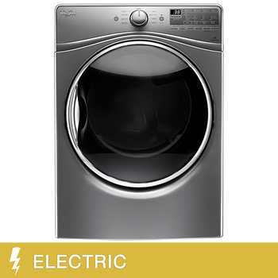
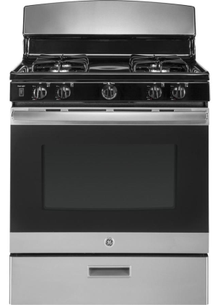


More than wattage?
Notes:
Categorizing energy consumption (3 slides: 5 - 8 minutes)
This slide will help students explore different means of powering devices — the energy sources, the requirements to power them, etc. The images on the slide will be the guide to the discussion and activity.
Divide students into pairs/small groups.
As a class, explore the similarities and differences between a refrigerator and a dryer. Together, you should identify that:
Similarities — both run on electricity; newer models of both are more energy efficient (they may not know this)
Differences — refrigerator draws a constant source of power/dryer draws power when in use; refrigerator doesn’t really have viable alternatives/dryer has viable alternatives
You may need to lead them toward determining some of these similarities and differences. They may also come up with other similarities and/or differences.

Slide 5
Try it!
Categorizing your energy consumption
Device | Type of Energy | Constant? | Alternative? | ? | ?
Refrigerator | Electricity | Yes | No
Dryer | Electricity | No | Yes
Television
Cell phone
Mower
Gas stove
Flashlight
Notes:
Categorizing energy consumption (2 of 3 slides)
This slide provides a visual example of a table for student pairs/groups to create. It is a guide — they can create it differently if they prefer.
Walk students through the process of creating a table to highlight the similarities and differences in the energy use between the devices.
Decide on the columns in the table. The example provides four columns, but they may think of more.
Create a table.
Complete the table with each of the devices
Let students know that you’ll put the collage back on the screen as well as how much time they have to complete the table.

Slide 6
More than wattage?
Notes:
Categorizing energy consumption (3 of 3 slides)
This slide will remind students which devices to include in their table.
Wander around the class to observe how students are completing their tables.
After students complete their tables, ask them what they put in for the rake — particularly the energy source.
To help transition to the next section, ask students to compare and contrast the cell phone and the flashlight. They’ll likely identify that they’re powered by batteries but that their batteries are different (rechargeable for phones). Both draw power when they’re turned on, but a phone is usually kept on whereas a flashlight is not.

Slide 7
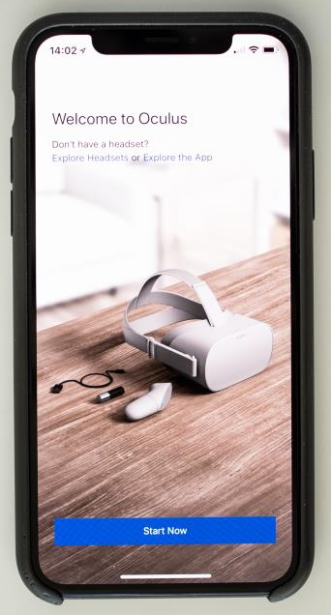
Try it!
Boy, those batteries
Pair up with another group.
Determine the average percentage
of battery charge within the group.
Phone with lowest charge: Predict its longest life.
Phone with highest charge: Predict its shortest life.
How long will it take to fully charge all the phones to 100% (starting at current battery levels and at 0%)?
Notes:
Delving deeper into batteries: Phone activity (1 slide: 7 – 10 minutes)
This slide guides students on completing a short activity that focuses on their phone batteries. Its main goal is to pique student interest in batteries — particularly rechargeable batteries.
Have student groups/pairs combine with another group/pair. There should be at least four students in each new group.
Ask them to get out their phones, reinforcing classroom rules on phones! Share that they will be focusing on the batteries, following the steps on the slide.
Walk through the steps:
Each phone will have varying percentages of charge. They should determine what the average percentage of the charge is among the group.
Whichever phone has the lowest percentage charge, they should figure out how to minimize battery use (while keeping the phone on) and then predict how long until the battery drains. To help do this, they can take steps to minimize battery use, monitor how long it takes to lose 1% and then extrapolate from there.
Follow a similar procedure with the most charged phone, except they should figure out what will drain the battery the fastest (e.g., many apps open, running video, fully lit screen, etc.). Then they should predict how quickly the battery will last.
Finally, they should predict the cumulative time to charge all of the phones to 100%, based on their current percentages and again as if all of them started at 0%/dead.
Have each group share its results.

Slide 8
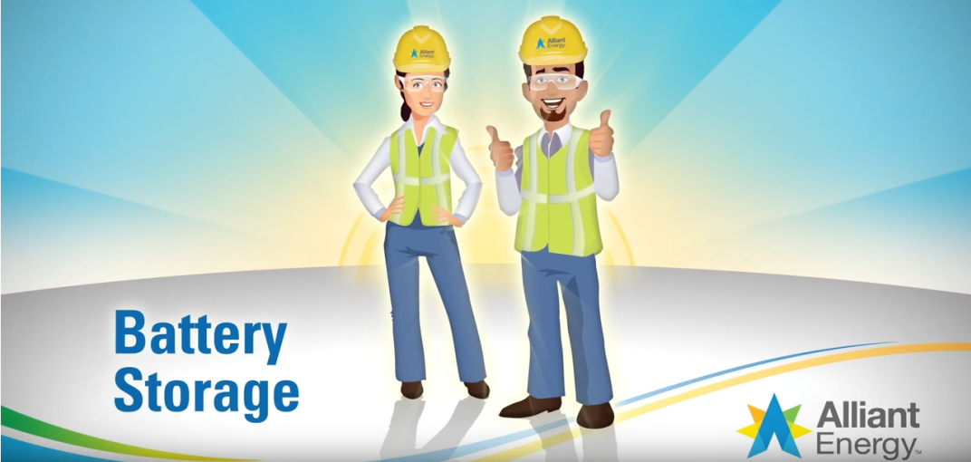
Battery storage
Notes:
Delving deeper into batteries: Video on battery storage (1 slide: 3 – 5 minutes)
This slide is a short video focused on the importance of battery storage for solar power, providing greater context for how batteries work.
Before showing the video, ask the class to identify other commonly used devices that are powered by batteries. As they identify a device, ask if the battery is usually or even always rechargeable. If they don’t mention an automobile, make sure that they include that in their list.
Ask them if they know of any examples where an entire home might run on battery power.
Show the video: https://www.youtube.com/watch?v=suj3Qbc4gpU
Ask students to identify and share any new information about batteries that they learned.

Slide 9
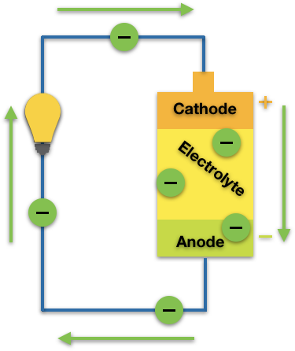
What happens inside a battery?
What’s the correct sequence?
Electrolyte blocks electrons and converts chemical energy into electrical energy.
Chemical energy is stored in the battery — electrons build up at the anode (negative).
Anode (negative) releases electrons that repel one another.
Electrons follow a circuit to move from the anode to the cathode.
Notes:
Delving deeper into batteries: What happens inside a battery? (2 slides: 3 – 5 minutes)
This slide provides a way to reinforce and review how a battery works. Students will try to put the processes that occur within a battery in their correct sequence.
Ask the class which way the electrons travel when a battery discharges (provides power) — from negative to positive or positive to negative? [Answer: from negative to positive.] They should remember that from the video and/or from looking at the diagram on the slide.
Using the diagram, have students (as a class or in their pairs/groups) try to determine the correct sequence of the process. This should take only a minute or two.

Slide 10
What happens inside a battery?
Correct sequence
Chemical energy is stored in the battery — electrons build up at the anode (negative).
Anode (negative) releases electrons that repel one another.
Electrolyte blocks electrons and converts chemical energy into electrical energy.
Electrons follow a circuit to move from the anode to the cathode.
Notes:
Delving deeper into batteries: What happens inside a battery? (2 of 2 slides)
This slide provides a way to reinforce and review how a battery works. It provides the correct sequence.
Walk students through the process to make sure they have the correct order. Here is a deeper description:
Batteries have stored chemical energy — regardless of whether they are rechargeable. There are electrons that build up in the anode/negative part of the battery.
The built-up electrons repel one another, so they try to travel. When the battery is put to use, it releases those electrons. Because opposites attract, the electrons move toward the postive cathode.
The electrolyte not only prevents the electrons from going straight to the cathode, it also converts the chemical energy into electric energy.
So then the electrons in the form of electric energy travel along a circuit providing power in the process and ending up at the cathode.
Charging a battery is the reverse of the process — electrons (supplied by the charger) move from the cathode to the anode.

Slide 11



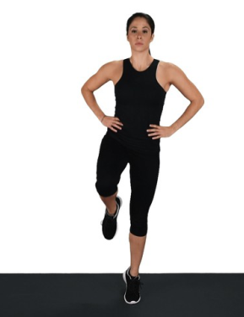
Try it!
How does this relate to
rechargeable batteries?
Notes:
Delving deeper into batteries: Charging and discharge simulation (1 slide: 5 – 7 minutes)
This slide and its activity can easily be skipped. It is meant mainly to reinforce and illustrate some key points of rechargeable batteries and to get students to move and expend some energy! They will do some short physical activities, requiring varying amounts of energy.
Set up the activity. In the pairs/small groups, each student will perform a different physical task. (If there are students unable to perform the physical tasks, they can help keep time and/or observe.) One student will run in place, one will be in the plank position, one will hop up and down, and if necessary, one will stand on one foot.
Making sure that they have enough room and have assigned one another to each of the physical activities, follow a pattern of:
25 seconds of activity
20 seconds of rest
20 seconds of activity
15 seconds of rest
15 seconds of activity
10 seconds of rest
10 seconds of activity
Stop
Give them some time to catch their breath, but ask them to consider the question on the slide. Once they’ve sufficiently caught their breath, explore the question. They should identify that:
How “charged” you are affects the amount of time/energy you have. This can mean that someone in better shape can go longer/harder and/or that as the activity progressed, and the “charge” went down, it got harder.
The harder the task, the more energy is required, which in turn depletes the battery more. Running in place takes a lot more energy/battery life than standing on one foot.
Recharging helps, and the more time to recharge, the more energy we can exert.

Slide 12
Show whatcha know…
Elaborate on the points below.
Devices require different amounts and types of energy.
Watts are a common way to measure electricity use.
Batteries store energy and convert it to electric energy.
Rechargeable batteries provide the power for many devices.
The harder batteries work, the more energy they discharge.
Notes:
Transition into next activity (3 – 5 minutes)
This slide is both a summation of the module’s key points thus far, as well as a transition to the next activity.
One at a time, have different students expand upon each bullet as a way to review the key points up until this point.

Slide 13
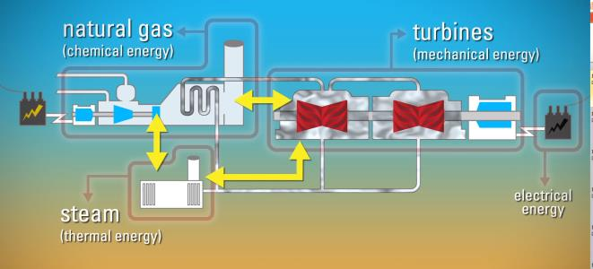
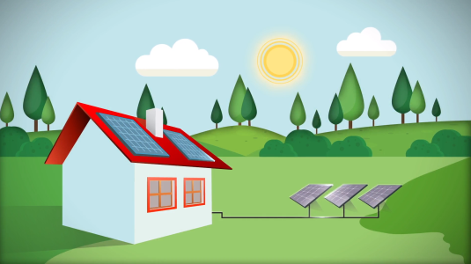
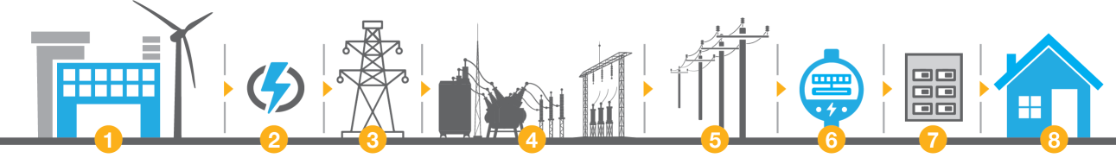
Power to power everything
Notes:
Researching power to the home: Exploring the Alliant Energy Kids website (2 slides: 25 – 40 minutes)
This slide is primarily to pique student interest in their research. This portion of the module will require access to the internet. You can do this as a whole class activity or as one in cooperative groups if each group can explore the Alliant Energy Kids website.
If this slide starts a new school day, leave it up as students enter the classroom. Ask students for a quick review of what they have learned thus far. (You can go back to the previous slide to help spur their memories.)
Share with students that they will ultimately create an energy audit for their homes — a way to evaluate and monitor their energy consumption. First, however, it’s important to understand how power is generated and provided to homes.
Set up the research that they will do (or you will do together as a class) by exploring the Alliant Energy Kids website and other energy education websites. The images on the slide are from elements on the website.

Slide 14
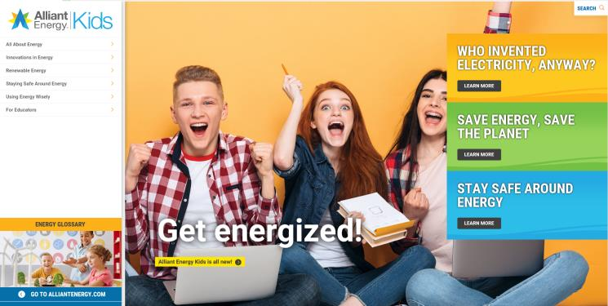
Power to power everything
Questions of inquiry
What’s the process for generating power? Can it be done in different ways?
How does electricity get to homes?
What’s a turbine, and how is it part of generating electricity?
What’s natural gas?
How does energy change forms before it gets to your home and in your home?
Notes:
Researching power to the home: Exploring the Alliant Energy Kids website (2 of 2 slides)
This slide provides guidance and points of inquiry for exploring the Alliant Energy Kids website and other energy-related sites.
Let students know that these are just some of the questions of inquiry to pursue in their research. Tell them that during their research, they should also identify at least three more questions of inquiry — questions that result from something they learn on the website. Ultimately they should be able to describe how power is generated and how it gets to and is distributed throughout the home.
Establish timeframes, expectations and parameters for their research. For example, do you want them to limit their research to the Alliant Energy Kids website? Do you want them to write down short answers for their questions of inquiry?
If students are working in groups/pairs, about halfway through the time, start asking them to share one of their questions of inquiry, why/how they decided on that and if they’ve addressed it yet.
Have students share what they’ve learned. Consider these ways to do that:
Have them share with the class one of the questions of inquiry they came up with, why/how they decided on that and what they found.
Take turns with each of the questions of inquiry and have different students share what they found.
Ask students to share something new that they learned from their research and/or anything that they had previously thought they knew but learned that they had it wrong or didn’t really know it.
Have each group come up with a question to share with the class (related to the research), and see if the other groups can answer it.

Slide 15
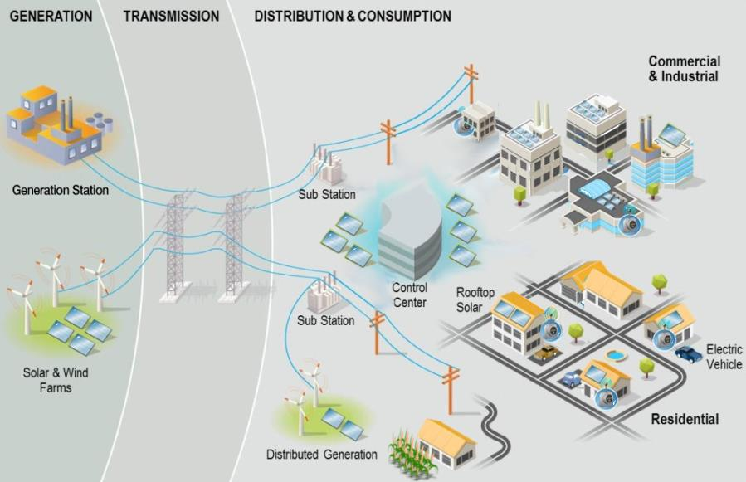
Power to power everything
How it all works
3 phases?
Generation?
Distribution?
Natural gas?
Consumption?
Notes:
Power to the home: The process (1 slide: 5 – 7)
This slide showcases an image that illustrates the key steps in getting power to the home. It is a way to review and reinforce a lot of what they learned in their research.
Give students about 30 seconds to inspect the image.
As a class, go over what is pictured — particularly as it relates to what they’ve researched. Ask these questions of students.
What three phases of supplying energy are depicted? (generation, transmission, distribution & consumption)
What are some of the ways that electricity is generated (generating station via steam created by coal and other natural resources, wind turbines, solar arrays)
How does it get from the generating source to homes? (transmitted through large wires to substations, then substations to homes and other buildings)
What about natural gas? How is it distributed? (though not depicted, natural gas is distributed through a network of pipes.)
And once electricity arrives in the home, how is it distributed? (through a series of circuits to outlets and directly to devices)
And what about natural gas in the homes? (through pipes that are buried underground and then piped into the home)

Slide 16
What to consider as you home in on it
An energy audit is an assessment of your home’s energy use — and how you can reduce waste and increase energy efficiency.
Are there places where the air leaks outside, wasting air that’s been heated or cooled?
Are there ways to insulate equipment such as water heaters to help them work better?
Do lights have energy-efficient bulbs?
Are appliances and electronics using power when they don’t need to?
Do you open/close curtains or windows to help control the temperature?
Notes:
Creating a home energy audit (2 slides: 15 – 20 minutes)
This slide helps guide students on creating their own energy audit that they will use at home. This helps set it up. This builds off of what they have been learning:
That different devices require different amounts (and sometimes different types) of energy to power them
That companies like Alliant Energy generate and distribute power to homes in multiple ways
Share with students that now that they better understand power use and generation, it is time for them to assess how they’re using it at home — in particular, can they be using it more efficiently?
Let them know that in their groups (or individually), they will be creating a template to conduct a home energy audit. Use the slide’s questions as a way to help set that up.

Slide 17



Your turn
Audit your home
Make sure your audit template includes …
A checklist of items to inspect
A rough estimate of the energy each item consumes in a day/week/month
A way to indicate if energy efficiency improvement is possible for each object
Notes on how to improve energy efficiency for each item
A projection of how much energy you could save by making changes
Notes:
Creating a home energy audit (2 of 2 slides)
This slide helps guide students on creating their own energy audit that they will use at home.
Set timeframes, expectations and parameters for creating their audit templates.
Check in on them as they create their templates.
Assign students to conduct their energy audits at home.

Slide 18


v
Hey there,
Energy Efficiency Inspector!
Alliant Energy congratulates you on successfully completing a home energy audit. Knowledge is power, so keep using what you learned for a better home and planet.
Notes:
Sharing their home energy audit (1 slide: 10 – 20 minutes)
This slide provides closure to the homework assignment.
Depending on the time you can devote, have students share their findings. You can have each share something individually or generally share as the class. These questions will help guide the process:
What are some of the “energy hogs”?
What are some of the energy wasters?
How can you make quick and easy changes to improve energy efficiency?
What are some more expensive and perhaps longer term changes to improve efficiency?
Were your parents interested in the audit? Did they participate?
What are some of the things that you taught your family?

