Slide 1
Input vs. output
Are they ever the same?

Slide 2
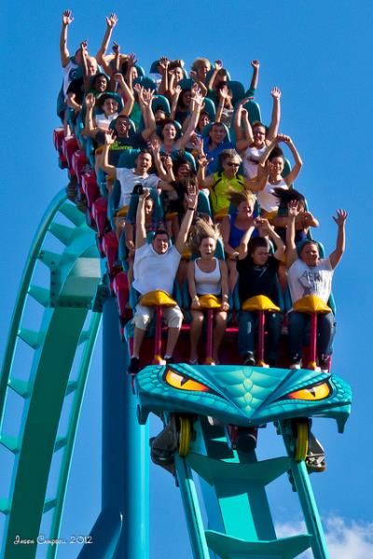
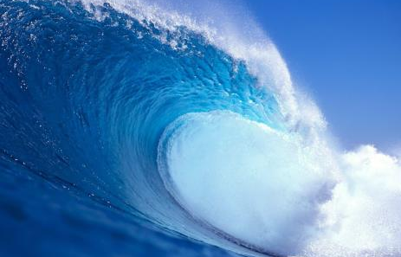
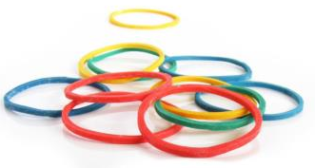
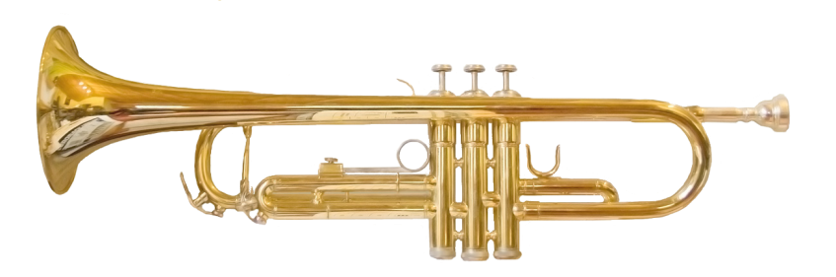
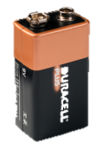
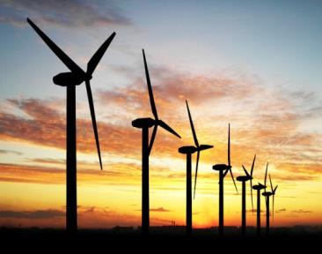
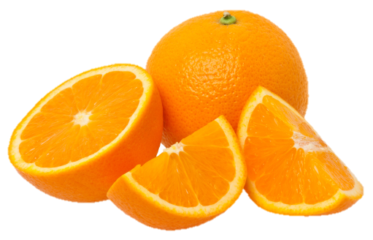
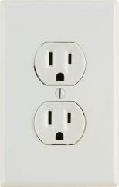
Potential
Kinetic
Notes:
Setting the stage (1 slide: 3 – 5 minutes)
Have this slide on display as students enter the classroom. If that’s not possible, be sure to leave it up for at least 30 seconds before introducing the activity.
Ask students to describe the slide — what does it present? How is it organized? Why is it organized the way it is? Work your way toward helping them recognize that these are all various forms of energy.
If it does not come up in the initial explanation of the slide, differentiate Kinetic vs Potential energy. Kinetic energy = energy of motion (elements big and microscopic). Potential energy = stored energy (food, gasoline, nuclear fission) and positional energy (gravity).

Slide 3
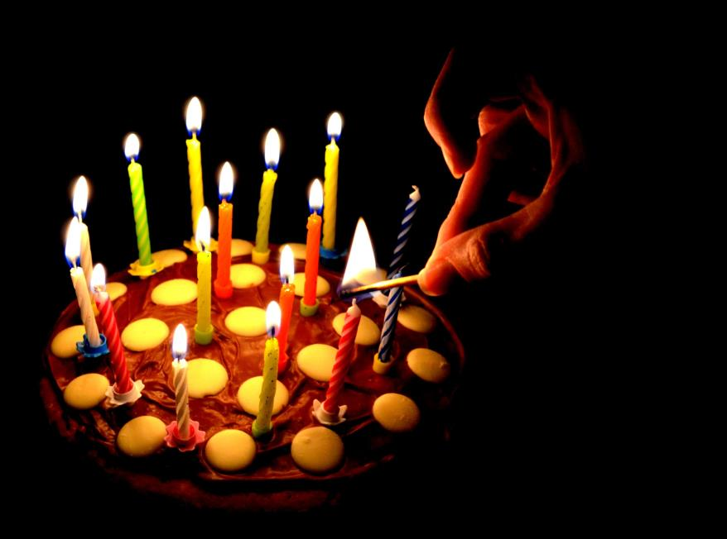
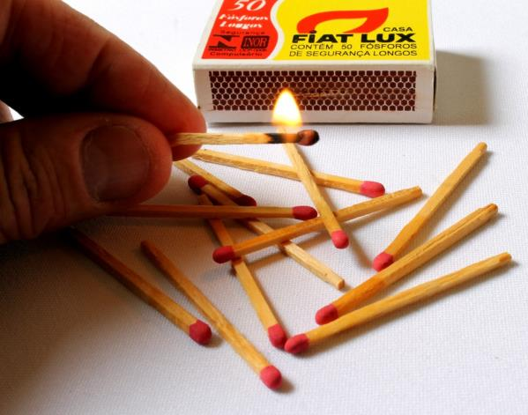
Energized?
Notes:
Introduction: Experiment setup (1 of 2 slides: 3 – 5 minutes)
Ask students to identify the energy sources and types of energy depicted. The match has potential energy (chemical). Striking the match requires potential energy (chemical from food), plus kinetic energy (motion and thermal). The lit match and candle have kinetic energy (thermal and radiant). The smoke has kinetic energy (motion and thermal). Chances are they won’t identify all of them. Keep asking questions about each element depicted until they recognize that energy goes into and/or is created by them.
After students identify each energy source, have them go through the entire sequence — i.e., the match has stored potential energy that becomes thermal and radiant energy when mechanical and heat energy are applied to it. And so on … the important take aways should be that students recognize that energy is transformed and transferred.

Slide 4
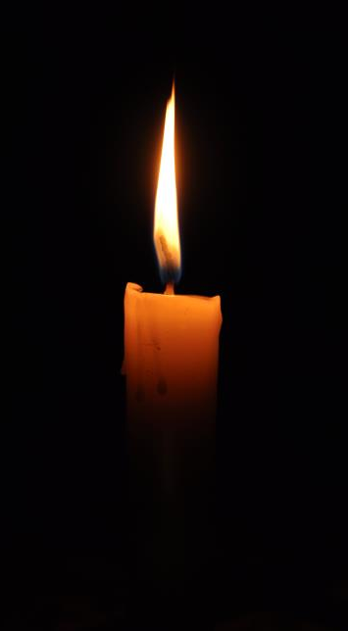
Try it!
Distance from candle (Measured feet) | Energy exerted (10-point scale)
Put out the candle.
Safely light the candle.
From two feet away, blow out the candle using
as little energy as possible.
Re-light the candle safely. Increase your distance
by a foot, and try again to blow it out.
Continue until the distance is too
great to blow out the candle.
Notes:
Introduction: Experiment (2 of 2 slides: 5 – 7 minutes)
Make sure students are in pairs or groups for the experiment. Share with them that they are going to be lighting candles and trying to blow them out from different distances.
As you distribute candles and matches, go over safety rules whenever experimenting, particlarly when a flame is involved. [See PDF for specific guidance, but it’s likely that your class has established safety rules for experiments.]
Walk students through the process, pointing out that they should create a simple table like the one depicted on the slide. Have every student take a deep breath and blow as hard as they can. Let them know that the energy they just exerted represents a 10 on the energy exerted scale.
Give them 3 – 5 minutes to complete the experiment.
Explore the results and experiences. Survey students to determine the various distances they were able to blow out their candles. Ask them how much more energy they exerted at the farthest distance relative to the closest.
Ask students why they had to exert so much more energy to blow out their candles from a greater distance. They will likely point out that the air that they blow isn’t as concentrated on the flame from a greater distance, that they’re less able to hit the flame directly, etc.

Slide 5

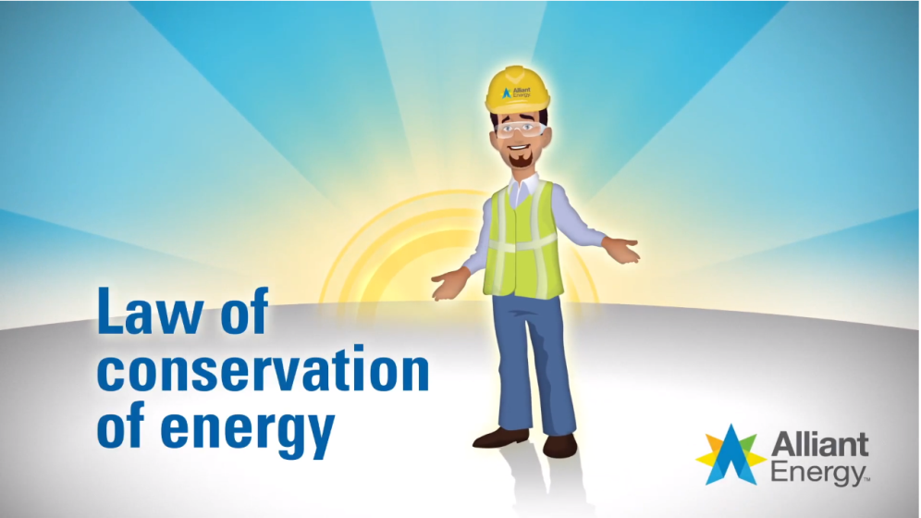
Law of Conservation of Energy
Notes:
Background: The law of conservation of energy (1 slide: 4 – 6 minutes)
Before showing the video definition of “law of conservation of energy,” ask students if it’s true or false that energy cannot be created or destroyed. Most students are likely to say that the statement is false — i.e., energy CAN be created or destroyed. Ask at least a couple of students to explain their answers.
Play the definition video: https://www.youtube.com/watch?v=Vx0yAS2u8gI
Ask a few students to share something that they learned from the definition, particularly as it relates to their experiment with the candles.
Watch the definition again.

Slide 6
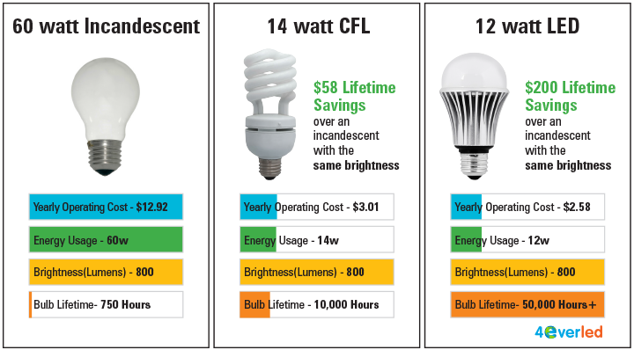
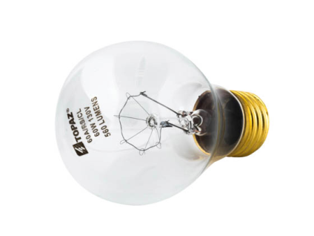
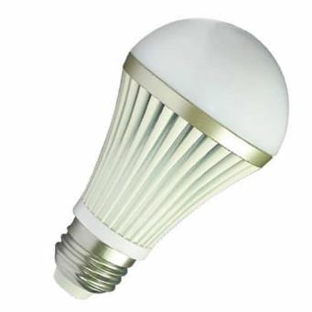
Incandescent vs. LED
LED = Light emitting diode
Notes:
Experiment: The law of conservation of energy (1 of 3 slides: 2 – 3 minutes)
NOTE: If you are unable to access incandescent bulbs, you can skip the experiment and refer only to the animated definition of the Law of Conservation of Energy, which references an incandescent bulb vs. an LED.
Based on the definition for the Law of Conservation of Energy, ask students to share how the differences between an incandescent bulb and an LED help illustrate the concept.
Once they’re able to connect the concept to the different bulb types, let them know that they’ll be doing an experiment that will help illustrate the differences.
But before they conduct the experiment, ask them about the differences in wattage between the bulbs, as illustrated on the slide. And then ask students what a bulb’s wattage means. (They may know, or they may not.) You can point out that a 60 watt incandescent bulb produces the same level of brightness (measured in Lumens) as a 12 watt LED. The primary value of this exploration is to determine what students arleady know or think they know about wattage.
Let them know that there’s a definition for watts that they’ll watch. They can see how accurate their defintions were.

Slide 7
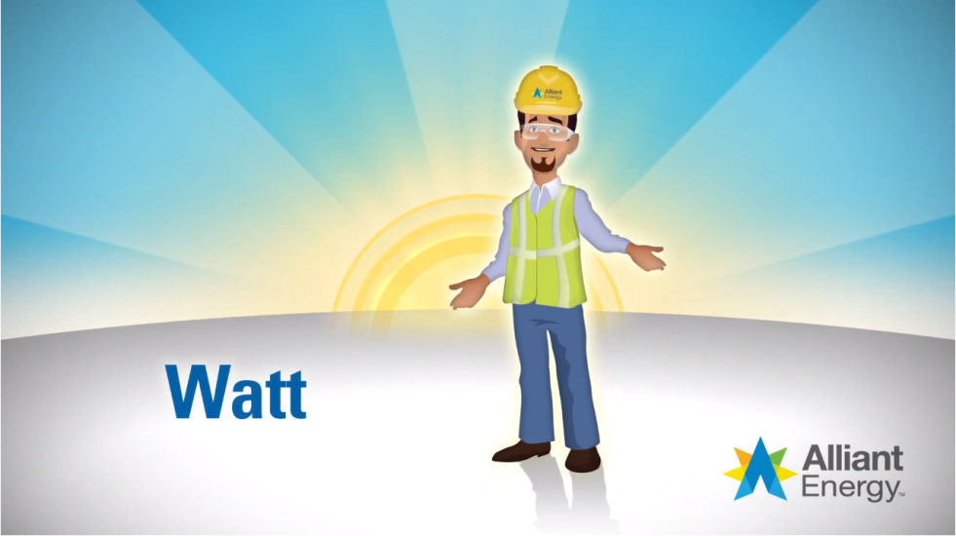
So … what’s a watt?
Notes:
Deeper Dive: Watts/Wattage (2 of 3 slides: 3 – 5 minutes)
Play the definition video: https://www.youtube.com/watch?v=xzsHkF1Mqvg
Give students the opportunity to modify and/or expand on their explanation of wattage/watts.

Slide 8
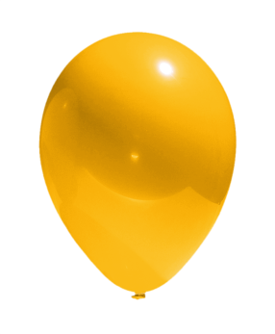
Try it!
Balloon vs. bulbs
Compare differences in heat between
an incandescent bulb and an LED.
Predict how long it will take for the incandescent bulb to pop the balloon.
Compare your prediction with the actual amount of time.
Approximate the amount of energy “wasted” as heat energy.
Notes:
Experiment: The law of conservation of energy (3 of 3 slides: 4 – 6 minutes)
NOTE: This experiment can be done with the entire class as a demonstration, if you’re unable to have enough individual light sources for small groups to perform the experiment.
It will require a working incandescent and LED bulb.
Walk students through the process of the experiment — they will compare the amount of heat each bulb produces, predict how long it will take for the hotter bulb (incandescent) to heat up enough to pop a balloon, test their predictions and then examine how much energy was wasted as heat.
Conduct the experiment. It is safest to have students put their hands close enough to the incandescent bulb to feel its heat without touching it, whereas, they can actually touch the LED without fear of its being too hot. Also, you may want to have the bulbs on for a while before beginning the experiment. That will speed up the bursting of the baloons.
As a class, compare predictions with actual amount of time. Why did some underestimate/overestimate the amount of time it would take?
Step 4 may be difficult for students to quantify. A good starting point is the wattage: 60 watts vs. 12 watt. It takes 5 times as much energy to light an incandescent bulb as an LED bulb. So students can think that it wastes 5x more energy and that the energy is transformed to heat energy.

Slide 9
Show whatcha know…
Elaborate on the points below.
Energy cannot be created or destroyed.
Kinetic energy and potential energy are the two main forms of energy.
Energy can transform into different types of energy.
When energy transforms, it often becomes more than one type of energy.
Notes:
Transition into next activity (1 slide: 2 – 3 minutes)
This is a review and transition into the next activity.
One at a time, have different students expand upon each bullet as a way to review the key points up until this point.

Slide 10
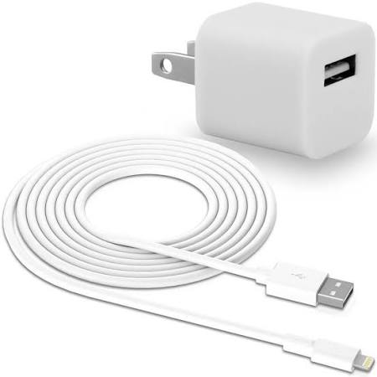
The law in action: efficiency vs. waste
True or false?
If a phone charger is plugged in but not charging a phone or a tablet, it still uses electricity.
True!
This is sometimes called vampire power, leaking elecricity or phatom load!
Notes:
Expanding into efficiency (1 slide: 1 – 5 minutes)
Pose the True/False question. Students are likely to say it’s true, even if they’re unsure. Whether connected to fully charged devices or no devices, a charger will draw a little electricity, sometimes referred to as vampire power, leaking electricity, or phantom load.
There is an Ask the Expert question on the AE Kids website that covers this topic more thoroughly: https://www.alliantenergykids.com/AllAboutEnergy/AskTheExperts

Slide 11
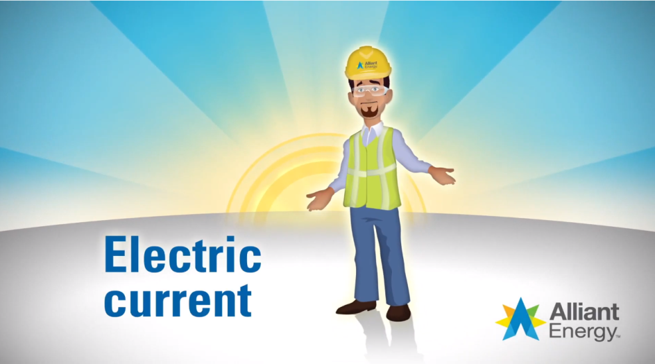
The law in action: Electric currents
Notes:
Expanding into efficiency (1 slide: 3 – 5 minutes)
So electricity charges batteries on phones. Electricity usually comes from outlets and wiring in the walls. Before showing the definition of “electric current,” ask students to define electricity. See if the class can quickly develop a consensus definition. It is likely to be along the lines of power/energy in homes etc.
Show the video definition: https://www.youtube.com/watch?v=tvWeHtqFId8
Ask a few students to share something that they learned from the definition.
Ask students to share examples other than electricity that provide power and energy to homes. They’re likely to come up with natural gas. They may even come up with sunlight (makes it so you don’t have to use lights and/or heat up the home as much), wind (to cool the home), etc.

Slide 12



Your turn
Stop the waste
Develop a definition of energy efficiency.
Create a list of things that use energy around the home.
Organize your list: frequency of use, amount of energy consumed, importance, type of energy.
Choose at least 10 items on the list and offer suggestions to make them more energy efficient and/or how to minimize wasting energy.
Notes:
Expanding into efficiency (1 of 2 slides: 15 – 20 minutes)
This section of the module has student groups identifying and assessing energy use around the home.
Guide students through your expectations for the activity, including setting time frames. Go through each step in the process, answering questions, etc. Step #3 is an excellent opportunity for students to create a table in Excel/Numbers. The slide provides suggestions for different columns, but students may think of other ways to classify their items. And by creating a spreadsheet, they can easily organize them in multiple ways — e.g., by frequency, by importance, by amount of energy consumed. Building spreadsheets will add a little time to the activity.
Check in with each group to assess their definitions for energy efficiency. In some cases, you may need to expand their definitions to include energy consumption beyond electricity.

Slide 13


Your turn
Stop the waste
Convince others to be more energy efficient!
Prioritize and organize your list from Step 4.
  How easy/difficult will it be for people to make the change?
  How much of a positive impact will the change make?
  What else should you consider for your recommendations?
6. Present your recommendations to the class.
Notes:
Expanding into efficiency (2 of 2 slides: 20 – 30 minutes)
This section of the module has the student groups share their suggestions for making an impact by minimizing waste and maximizing the potential for input to equal output. Though this is a continuation of the previous slide, we strongly suggest ensuring that all of the groups complete Steps 1 – 4 before introducing Steps 5 and 6.
Share with students that they will continue their assessment of steps that will minimize waste/maximize output relative to input. Their task is to make recommendations. Those recommendations should consider the questions posed in Step 5. Go over Step 5 as a class. Ask what factors influence the ease/difficulty for making a change. (Cost, change of lifestyle/habit, people required to make the change, etc.)
Set your time expectations and presentation expectations.
Have student groups report out some of their items and suggestions. Ask them to identify at least one that they believe would be easy to implement and one idea that may be surprising — i.e., one that not many people would think about.

