Slide 1
Renewable energy challenge
An energizing project

Slide 2
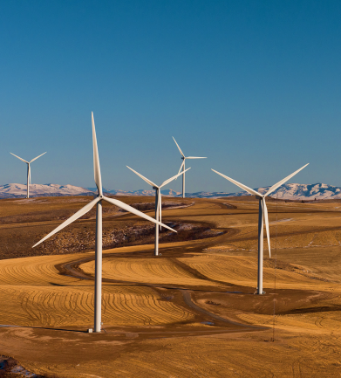
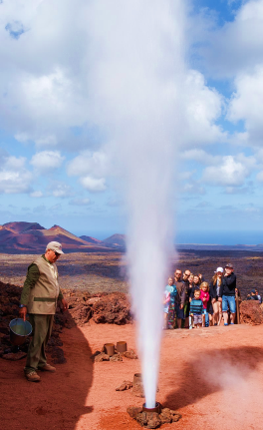
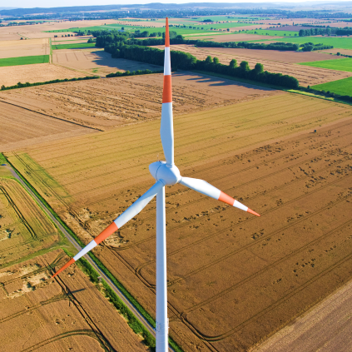
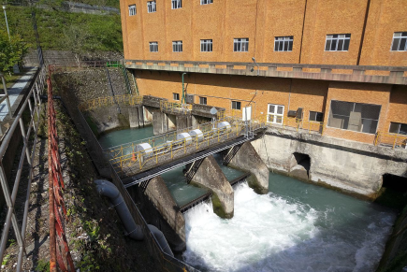
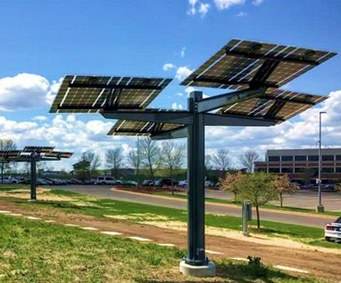
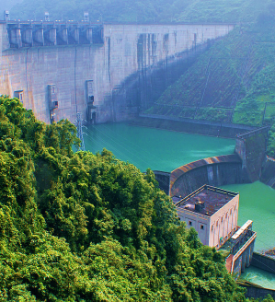
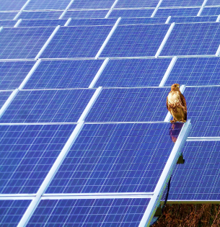
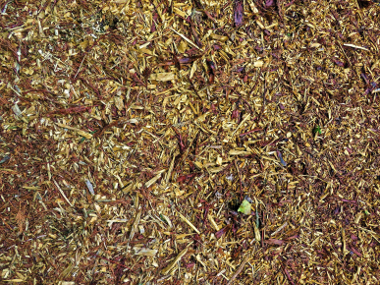
Energized for renewables
Notes:
Setting the stage (1 slide: 3 – 5 minutes)
Have this slide on display as students enter the classroom. If that’s not possible, be sure to leave it up for at least 30 seconds before introducing the activity.
Ask students to speculate on what the images have in common. Once they’ve had the chance to think about it, ask a few students to share how they think the images relate to one another. (If they struggle, point to the title of the slide as a hint.)
Once you reach the point where students agree that the images depict sources of renewable energy, ask for a show of hands from those who know very little about renewable energy, then from those who know a few things, then finally from those who think they know a lot about renewable energy.
Let students know that you’re going to give them the chance to test themselves to see how much they know.

Slide 3
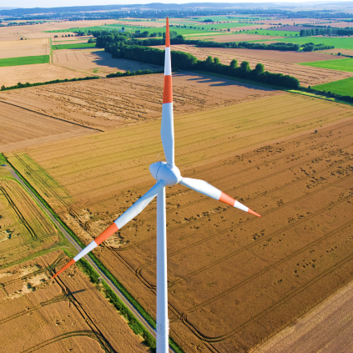
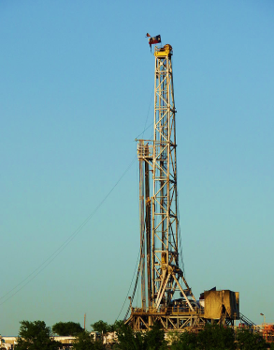
Which does not belong?
Oil rig
renewable energy [n]: energy from sources that can be replenished and replaced through natural phenomena and/or developed through cultivation.
Notes:
Setting the stage: Multiple choice quiz (9 slides, 15 – 20 minutes) CORRECT ANWER IS THE OIL RIG. Students may recognize that the oil rig is the only image that is different from the previous slide, but they’ll likely know that oil is not a renewable resource.
Decide how you want to solicit answers for the following quiz questions and let students know your expectations.
Ask students to identify 5 different renewable energy sources. (Students should be able to come up with at least 3.) If they can’t identify all 5, tell them that you’re going to keep going and that they can see if they can determine renewable sources they’ve left out.
solar
wind
hydro
geothermal
biomass

Slide 4
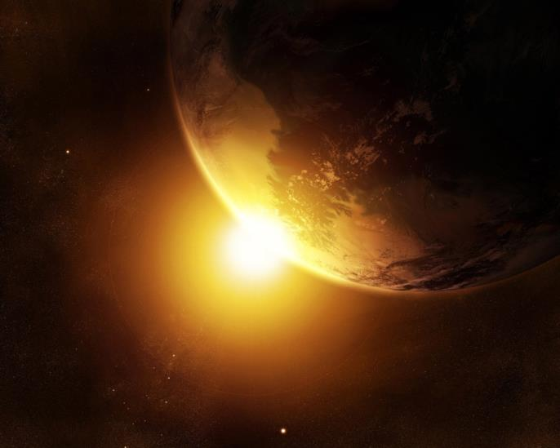
Energized for renewables
True or false?
More solar energy hits the earth in one hour than the world uses in one year.
True
Every hour, 430 quintillion joules of energy from the sun hit the earth.
Notes:
CORRECT ANSWER IS TRUE. (2 of 9 slides)
After revealing the answer, ask students how many zeros are in quintillion. (18)

Slide 5
Energized for renewables
True or false?
In the six years between 2014 and 2020, the number of homes in the U.S. with solar power will grow by approximately four times (4x).
False
The actual amount is expected to be 8x more homes using solar power than there were in 2014!
Notes:
CORRECT ANSWER IS FALSE. (3 of 9 slides) The slide reveals that the answer is double that number — 8 Xs growth in the 6 years. Students will likely miss this one because it seems as though it should be a true answer. It’s important that they recognize that it’s actually significantly greater growth.
Ask students if any of them have solar panels at home. Ask if they know if their parents plan to add solar panels in the future.

Slide 6
Energized for renewables
How many homes can one wind turbine power for a year?
3
33
133
900
900 Alliant Energy’s newest turbines generate enough energy for approximately 900 homes a year.
Notes:
CORRECT ANSWER IS D. (4 of 9 slides) Students may guess this correctly because it’s the largest option. The number of homes powered by a wind turbine can be over 1,000 for larger turbines. This estimate is based on the turbines Alliant Energy is currently installing in their newest wind farms. The next slide features one of the larger turbines currently in operation.
Before or after you reveal the answer, ask students to guess how many kilowatt hours the average home uses in a year. (around 10,000) This number may not have much meaning to them, but it at least quantifies the amount to power that the turbine generates.
As a set up to the next slide, you can say that this is based on an average sized turbine. You can also share that in 2017, new wind turbines added more than 7 gigawatts (7,000 megawatts) of capacity around the world.

Slide 7
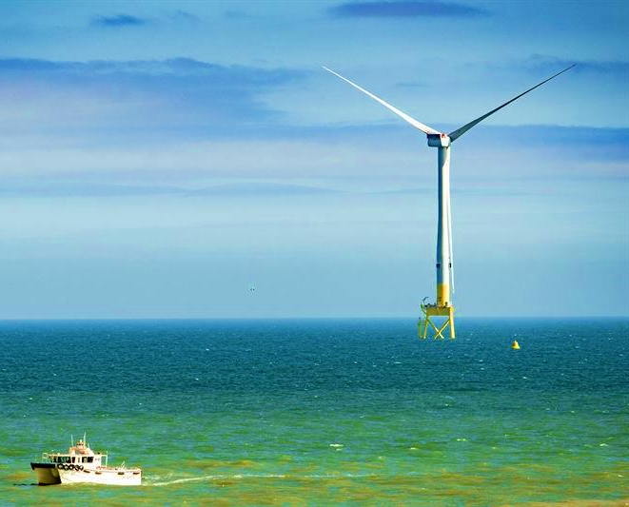
Energized for renewables
A huge wind turbine went “online” in April 2018 off the coast of Scotland. How big are its rotor blades?
27 yards
47 yards
67 yards
87 yards
87 yards – 80 meters
One rotation of its rotor blades generates enough power for one home for one full day!
Notes:
CORRECT ANSWER IS D. (5 of 9 slides) The rotors are 80 meters. The company says that one rotation generates enough power for one home for one full day!
Before going over this question, ask students what some of the advantages are for being in the ocean. They’ll likely come up with advantages like, constant wind, stronger wind, open space/more room for giant turbines. Then ask about some disadvantages — e.g., difficult to access/repair, more prone to stress (weather, waves, tides, etc.)

Slide 8
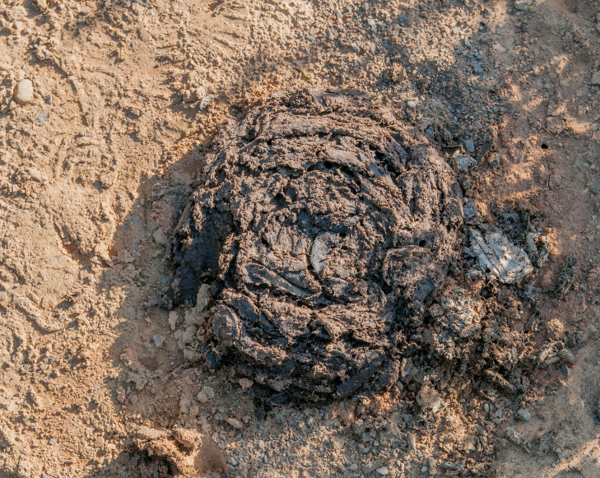
Energized for renewables
True or false?
Electricity can be created from animal poop.
True
Biomass is a natural material that is used as a fuel. Trees, plants, trash and yes, even poop, are types of biomass used to produce electricity.
Notes:
CORRECT ANSWER IS TRUE. (6 of 9 slides) Students are likely to guess this correctly. Poop is an example of biomass. So students may now realize that biomass is one form of a renewable energy source.
If students had not already identified biomass as a renewable energy source, quickly review all that have been identified at this point. If you’re still missing any, let them know how many more are yet to be named. (There are a total of 5.)
Ask students to explain how they think the stored energy in biomass can be converted to electric energy. At minimum, they should be able to guess that the biomass is burned. They may also know that the burning biomass can create steam to power generators to create electricity!

Slide 9
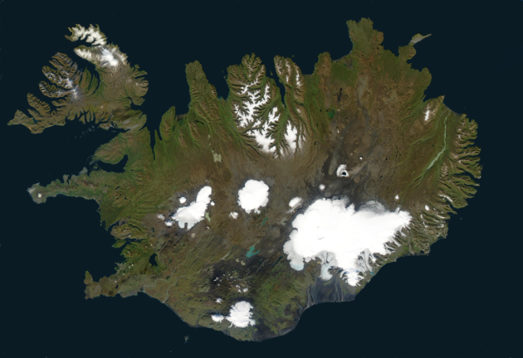
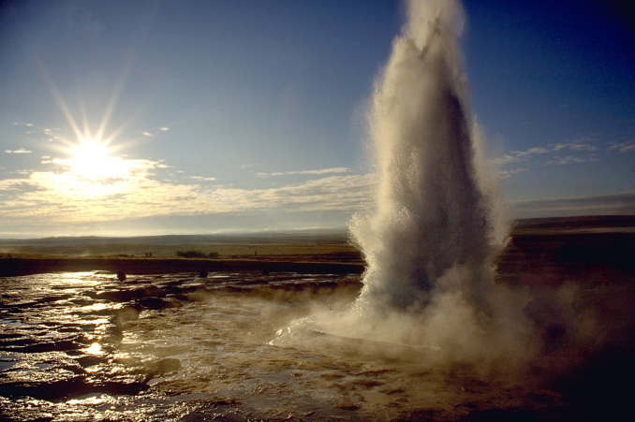
Energized for renewables
Iceland is a small island country in the North Atlantic with a population of less than 400,000. What percentage of their electricity is generated from geothermal energy and hydropower?
25%
50%
75%
100%
100%
Notes:
CORRECT ANSWER IS D. (7 of 9 slides) Islands formed by volcanoes have significant geothermal activity, so it’s not surprising that Iceland relies heavily on geothermal energy as a power source. It is also a mountainous country with many flowing rivers. AND it has a small population. Still, it’s impressive that 100% of its electricity is generated from renewable sources! This may be a point where students recognize another form of renewable energy.
At this point, all 5 forms of renewable energy sources should have been identified. Review them: solar, wind, hydro, geothermal, and biomass.
Since Iceland gets 100% of its power from renewable energy sources (two different sources), ask students to speculate on how much the U.S. generates from all renewable energy sources. In 2017, it was approximately 17% — hydropower being the most prevalent.

Slide 10
Renewables vs. fossil fuels
Coal is NOT a renewable resource – it’s a fossil fuel. Silicon from sand is a key component of photovoltaic cells (PVs), which create electricity from solar energy. How many tons of coal are required to produce as much electricity as the number of PVs that can be created from just one ton of sand?
50,000 tons
100,000 tons
250,000 tons
500,000 tons
=
1 ton of sand
?? tons of coal
500,000 tons
How many more pounds is that?!
Notes:
CORRECT ANSWER IS D. (8 of 9 slides) The way this question is asked may be a little confusing for students, so you may need to make sure they get its gist. Sand is required for the silicon in PVs, crucial components for solar electricity. While we can get energy directly from sand, it’s a resource that most be collected. So this question compares the amount of one resource compared to another to create the same amount of electricity. The difference is massive!
Have students convert the tonnage into pounds of coal (1,000,000,000 to help reinforce how much more 500,000 Xs greater the amount is. For many students, 1 billion pounds will seem like a whole lot more than 2,000 pounds.
Ask students why they think this question is included — what does it help illustrate? They’ll likely know that coal is a key source of carbon emissions, that coal excavation is dangerous, that transporting 500,000 tons of coal is expensive, etc. And the question is reinforcing many of the benefits of renewable energy sources by quantifying some of the differences.

Slide 11
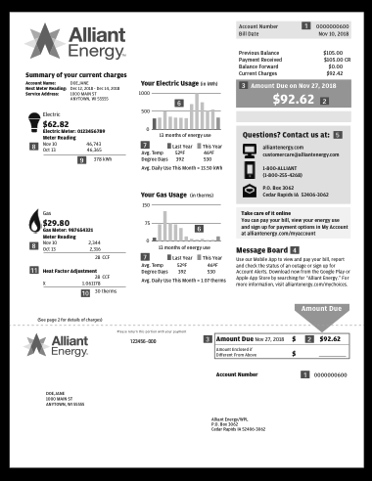
Energized for renewables
In the U.S., the amount of energy consumed doubles every 20 years, thanks in part to a growing population and a growing number of electric gadgets in our lives. At home, what usually accounts for about half of the energy bill?
Televisions, computers, device charging
Heating and cooling systems
Refrigerator(s), freezer(s)
Washer, dryer
Heating and cooling systems
Will that trend of doubling every 20 years continue?
Notes:
CORRECT ANSWER IS B. (9 of 9 slides) Heating and cooling systems (HVAC, water heater) typically account for 48% of the energy bill. A clothes dryer is often the appliance that uses the most energy when it’s in use – BUT, it’s used much less often than heating/cooling systems. Students may also think that the answer is A, since the question mentions electric gadgets. This question is intended to ensure that students focus on energy use, elevating the value and importance of renewable energy sources.
Ask students to explain the rationale of their choices — why they believed certain appliances or devices consume roughly half the energy in a home. Their reasoning should help give some insight into their perspective on personal energy consumption and energy consumption in general.
Since this is the last multiple choice question, as a review, ask students which questions/answers most surprised them and/or interest them.

Slide 12
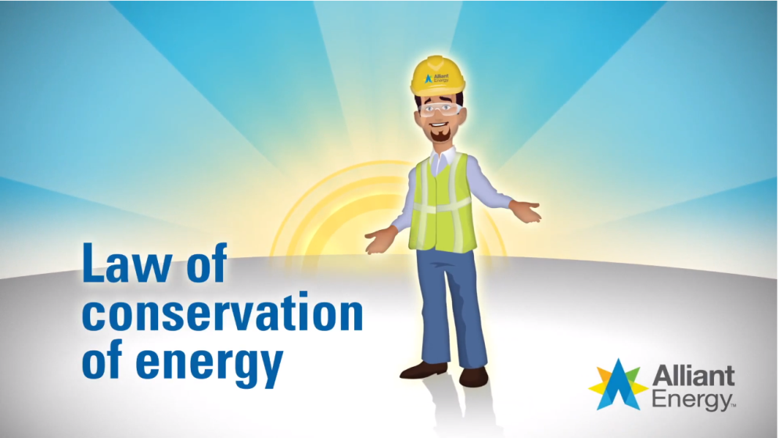
Where does the energy go?
Notes:
Transition: Defining the law of conservation of energy (1 slide: 7 - 12 minutes)
Renewable energy sources are clear examples of energy transfer from one form into other forms — ultimately, electric energy. This slide presents a definition for the Law of Conservation of Energy — a law of physics that zeroes in on energy transfer.
Before showing the definition, ask students if they know what the Law of Conservation of Energy means. Accept multiple explanations, giving little indication of accuracy and asking only for clarification if needed.
Show the definition video: https://www.youtube.com/watch?v=Vx0yAS2u8gI
As a class explore how the definition of the Law of Conservation of Energy relates to renewable energy sources. Connections can include:
Since energy is neither created nor destroyed, there is a lot of energy in the world that is renewable.
It can be a challenge to capture/harness forms of renewable energy.
The transfer of energy from one form to another is how renewable energy sources become useful.
The “loss” of energy with renewables in transferring to electrical energy isn’t necessarily “wasteful,” because the source (i.e., the sun) has an infinite supply.
Let students know that they’ll be working on some experiments that help illustrate the transference and conversion of energy.

Slide 13
Try it!
Catch some air
Gravity creates potential energy that converts into kinetic energy in the form of a bouncing ball.
Rely only on gravity
Maximize energy transfer
Produce the biggest bounce
Notes:
Experiments: Energy conversion & transference (2 slides: 20 - 25 minutes)
These two slides emphasize experiments that help illustrate energy conversion and transference. This slide focuses on an experiment with a tennis ball and a basketball that you can do with the whole class. You will challenge students to figure out how to propel the tennis ball the farthest, using only gravity to initiate the action. By dropping the two balls together with the tennis ball atop the basketball, you can maximize the energy conversion (from potential to kinetic) and transference (from basketball to tennis ball) to propel the tennis ball.
You will need:
1 tennis ball
1 basketball
Enough space that an errant flying tennis ball won’t do any damage!
Set up this first experiment/challenge. Showing the two balls, tell students that you want to figure out how to transfer/convert energy in ways that will make the tennis ball bounce the farthest, using only gravity. Ask students if any have already seen or done this before, and if so, to remain quiet at first.
Drop each ball separately to show how high they bounce. Then create a point of reference by adding a little force to the bounce. Let students know that there’s a way to make the tennis ball bounce even more than that using only gravity.
Entertain theories of how to do it, allow for experimentation (that doesn’t pose too much danger of a flying basketball, tennis ball and/or students climbing to heights to drop the balls) Students may arrive at the solution immediately or require time and attempts to discover it.
Once students arrive at a good solution, repeat it for everyone to see. Ask for explanations of why it works the way it does. They should be able to identify that the (kinetic) energy from the basketball transfers to the tennis ball. Potential energy converts to kinetic energy and then transfers from one object to the other.

Slide 14
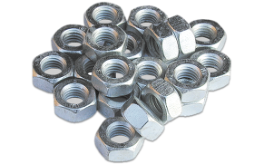
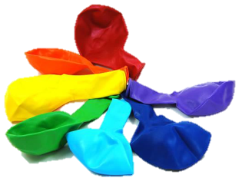
Try it!
Convert and transfer
Challenge: Create a chain of energy conversions and transfers using your objects.
Where does energy seem to be wasted?
How can you:
Transfer energy among the most objects?
Create the most energy at the end?
Notes:
Experiments: Energy conversion & transference (2 of 2 slides)
This slide focuses on having student groups experiment and try to create chains of energy transference and conversions using the objects that you provide. By its nature, this activity is likely to involve a lot of trial and error — i.e., more informal experimentation. You will need to decide the degree to which you want students to document their attempts. Additionally, the amount of time you devote to this can vary depending on how deeply students engage, the number of objects that you provide, and the number of different challenges you pose. As a result, this may exceed the time referenced on the previous slide.
You will need as many of the following as you can find:
rubber bands
balloons
magnets
balls/marbles
matchbox cars
nuts — heavier nuts that can be tied to a string, like a pendulum
springs
string
inclined planes
pulleys
Divide students into groups/pairs and set up the basic challenge. Once students understand the gist of what they’re doing, you can add other challenges like those referenced on the slide. They can try to create a series of energy transference using as many objects as they can. They can try to create the greatest energy output at the end.
Establish guidelines and expectations for safety and general decorum.
Set the expectations for the time they’ll have, challenges, etc. You should also encourage students to consider:
Is the chain of conversion/transference consistent? If not, why not. (They should complete the chain at least 3 times to gauge its consistency.)
Where does it seem like energy is wasted in the transference/conversion?
Which objects seem to be more efficient? More conducive to energy transference?
Observe the groups at work the way you normally do.
Have students demonstrate at least one chain of conversion/transference for the entire class, describing what they observed in arriving at that final chain.

Slide 15
Show whatcha know…
Elaborate on the points below.
Energy comes in multiple forms.
Energy isn’t created or lost.
Energy can convert to different forms and transfer to different objects.
Points of transfer/conversion are often where energy is “lost.”
Notes:
Transition into next activity (3 - 5 minutes)
This slide helps sum up what students learned from their experiments.
One at a time, have different students expand upon each bullet as a way to review and set up the activity.

Slide 16
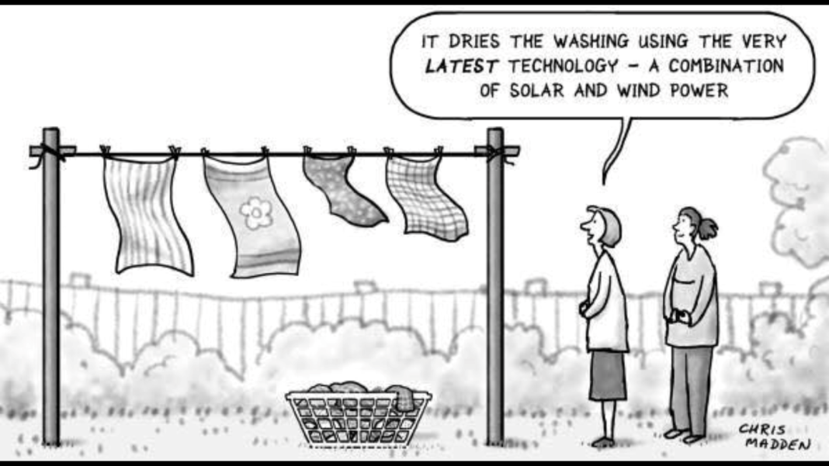
Just for fun
Notes:
See if students get the joke: Renewable energy is a hot topic, but it’s been around for forever! Humans have been using energy from the wind, sun and water for generations.

Slide 17
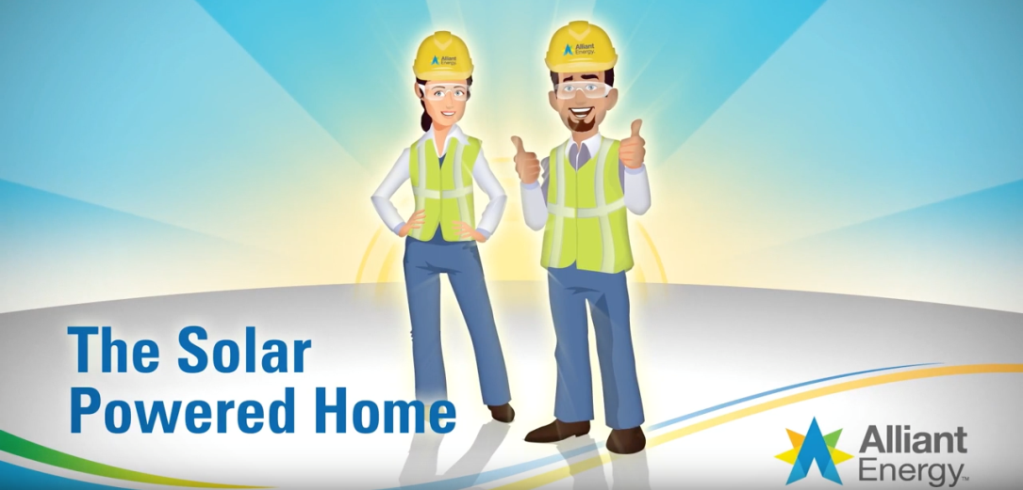
Renewing the focus on renewables
Notes:
Solar power: Video on the solar-powered home (1 slide: 5 - 7 minutes)
This slide links to a short video on how solar power works in general — with a specific focus on solar power at home.
Before showing the video, ask students if they remember how much energy the sun produces in an hour. They should remember that it’s more than the world uses in an entire year. They may also remember that it’s 430 quintillion joules of energy.
Show the video: https://www.youtube.com/watch?v=O8sd_juIjU8&feature=youtu.be
Show the video.
Ask students to identify all of the instances of energy conversion and transference depicted in the video.
Solar energy transfers from the air/atmosphere to PVs.
PVs convert solar energy into electric energy.
PVs transfer electric energy to power grid/directly to home.
Electric energy transfers to light energy (and a little heat energy).

Slide 18
Renewing the focus on renewables
Notes:
Renewable energy and electricity: Defining turbine (1 slide: 3 - 5 minutes)
The definition for turbine focuses largely on a wind turbines and provides an explanation for the transfer of energy from wind to mechanical energy to electric energy.
Before showing the definition, ask students to recall some of the facts about wind turbines that were highlighted in some of the quiz questions at the beginning of the lesson.
The average wind turbine can produce enough electricity to power more than 300 homes.
The largest wind turbines can produce enough electricity in only one rotation to power a home for a day.
Use of wind power is increasing rapidly — e.g., 7 gigawatts added to the power grid in 2017.
Show the definition: https://www.youtube.com/watch?v=X3XgIueu4xk&feature=youtu.be
Ask students to identify all of the instances of energy conversion and transference depicted in the video.
Wind energy converts into mechanical energy with the rotors/turbine.
Turbines convert mechanical energy into electric energy (a generator is also part of the equation).
Potential energy in fossil fuels converts to thermal energy.
Thermal energy converts into mechanical energy with the turbine.
Turbines transfer electric energy to power grid. (Students may break this down more to talk about the generating station.)
Electric energy transfers to light energy (and a little heat energy).
Let students know that they will eventually be participating in a design challenge to create a way to generate power from a renewable resource. Could be from solar energy. Could be like a wind energy.

Slide 19
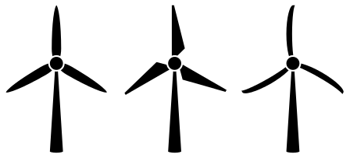
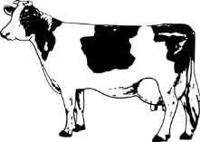
Winding through research on renewables
For each type of renewable energy, consider:
How easily is the renewable captured and converted for use?
How available is the renewable — is it limited to certain parts of the world?
What are obstacles and challenges to better utilizing the renewable?
What are the main advantages of utilizing the renewable, compared to nonrenewable sources or even other renewables?
Are there any negative consequences of utilizing the renewable?
Notes:
Renewable energy research (2 slides: 30 - 45 minutes)
This slide provides students with some guiding questions for exploring more about renewable energy. You will need to decide how much time to allow students to do their research, how they will do their research, etc. The primary rationale for this portion of the module is to capitalize on student interest in renewables and help them develop a broader understanding of renewables before starting their design challenge. If you need to abridge the module, this can be cut out of the process.
Share the research parameters and expectations with students — e.g., how much time they have, individual vs. group research, source limitations, etc. The Alliant Energy Kids website (alliantenergykids.com) provides a wealth of information on renewable energy. You can simply have students conduct their research using the website. Additionally, to help students strengthen their media literacy skills, you can emphasize having students analyze any of the sources they consult in their research. Does a source have an agenda? Does the source present a biased perspective?

Slide 20
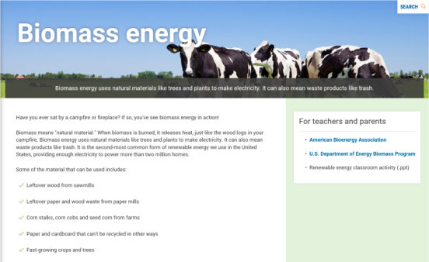
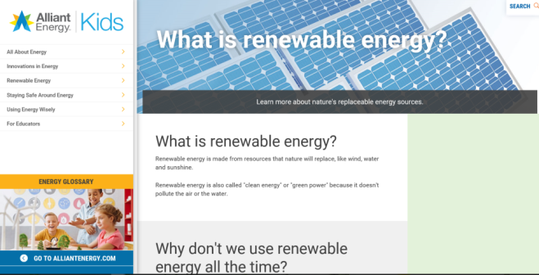
Winding through research on renewables
Be sure to consider:
Process(es) for capturing and utilizing the renewable
Challenges to better utilizing the renewable
Technological advancements that will make the renewable more useful in the future
Potential ways to minimize any negative consequences of using the renewable.
Notes:
Renewable energy research (2 of 2 slides)
This slide provides additional guidance on outcomes for and assessment of students’ research. These bullet points reflect processing information that the questions on the previous slide help students in their inquiry.
Make sure that students understand the thrust of each of the bullet points.
If the research takes place at school, check in on what they are discovering.
As a class, use the bullet points on this slide for students to identify what they discovered and how they processed the information.

Slide 21
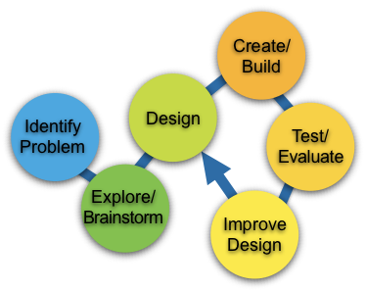
Your turn
Engineering some energy
Many advancements in renewable energy have resulted from the work of engineers. Engineering often begins with a problem to solve — sometimes multiple problems. Plan, design, build, test, repeat!
Challenge: Create an apparatus that uses a renewable energy source to generate power.
Engineering design process
Notes:
Engineering design challenge (2 slides 45 – 90 minutes)
These slides guide students in their design challenge: to create an apparatus that “powers” an action/activity using a renewable energy source. It is important for you to decide how open-ended you want the experience to be. For example, will students be limited by the materials that you provide? Or will they be able to bring materials from home? How much class time will you allow? (Make sure you account for time for students to demonstrate their projects.)
In order to replicate renewable energy sources within the design and demonstration, students may need to use fans (wind), hair dryers (heat and/or wind), heat lamps (heat), handmade waves for water current, etc.
Maintain the same groups/pairs or create new ones, and set up the basic challenge. They will be engineers, designing mini wind turbines, water-powered apparatuses, etc. It is important for students to understand that whatever they build must power something.
Establish guidelines and expectations for safety and general decorum.
Set the expectations for the time they’ll have, limitations on materials they can use, etc. (The next slide breaks down the design process, so you may want to provide time expectations for each step in the process.)
If you use the rubric that is provided, hand it out and go over it.

Slide 22
Your turn
Engineering some energy
Identify problem(s): What’s the challenge/obstacle? (5%)
Explore/brainstorm: How will you address the challenge?
What can you learn from others? (20%)
Design: Which of your ideas best address the challenge? Plan them on paper, including the materials you’ll need. (25%)
Create/build: Do you need to tweak the design as you build? (30%)
Test/evaluate: Does the design meet the challenge? Does it work each time? (10%)
Improve design: What changes would improve performance? (10%)
Challenge: Create an apparatus that uses a renewable energy source to generate power.
Notes:
Engineering design challenge (2 of 2 slides)
Leave this slide up as they work on their projects. The percentages correspond with the approximate amount of time they should spend on each step in the process.
Go through each step in the design process. Ask students to explain what they think each of the steps means. Provide any guidance as necessary. See if they can guess what the percentages mean.
Observe the groups at work the way you normally do.
When it is time to demonstrate their apparatuses, have a student share about the group’s experiences during the design process. Some questions to consider for prompting reflection:
Did your group spend around half the time planning?
How many different ideas did you generate during brainstorming?
Did you research to see if any others had attempted similar ideas?
Did you do actual drawings during the design phase?
Did you tweak the design while you built it?
Did you test elements as you built it?
How did you test it?
How many times did you test it?
What did you learn from testing?
How did you decide to make changes?

